Slide 1
Deep Learning !
Image Classification In Tomato leaf Disease Detection Using Convolutional Neural Network

Slide 2
#. Introduction!
To increase the agricultural productivity , improve the performance of growth in tomato plants.
To ensuring the health and productivity of plants and maintain the growth.
Facilitate of timely intervention , essential to prevent or mitigate negative outcomes.

Slide 3
#. Motivation!
Timely pesticides for plants disease was provided by expert people in village , and its take time to give timely treatment.
We have no such software application which classify such the Tomato leaf disease.
We have designed the model which will detect disease in less time and provide satisfactory solution .

Slide 4
#. Task !
Trained a custom CNN from scratch , obtained a better performance on our CNN MODEL.
Used various pre-trained model for tomato leaf dataset , to find out the best accuracy model for our dataset.

Slide 5
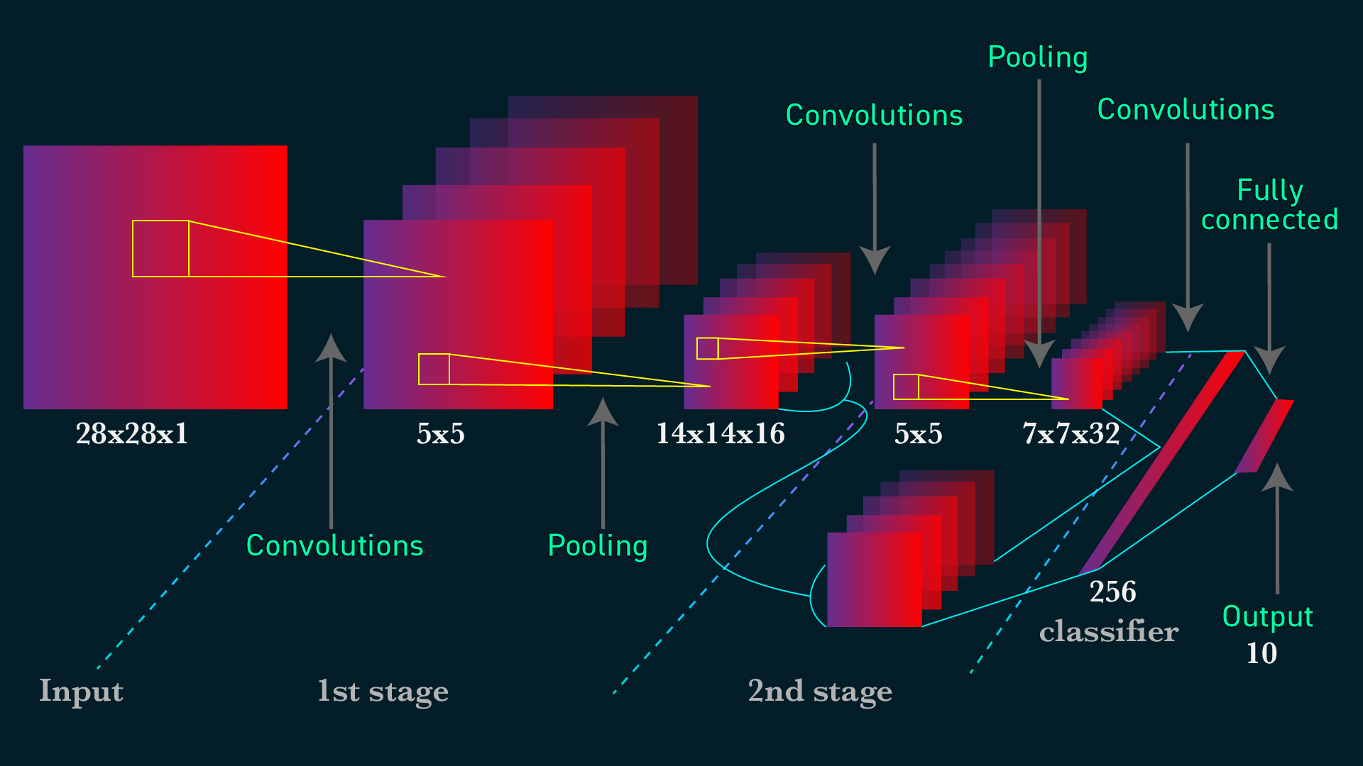
#. General Architecture:

Slide 6
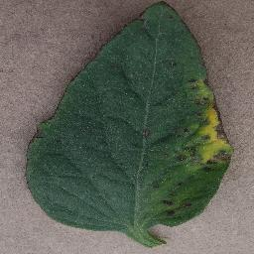
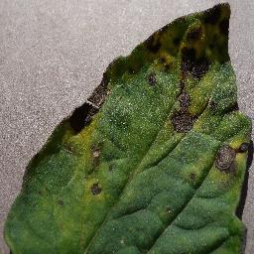
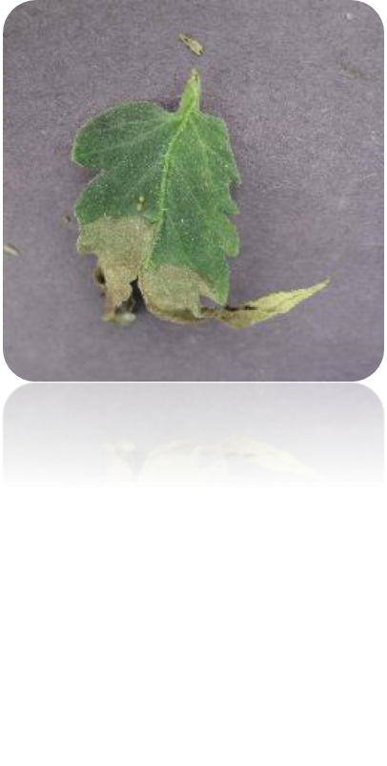
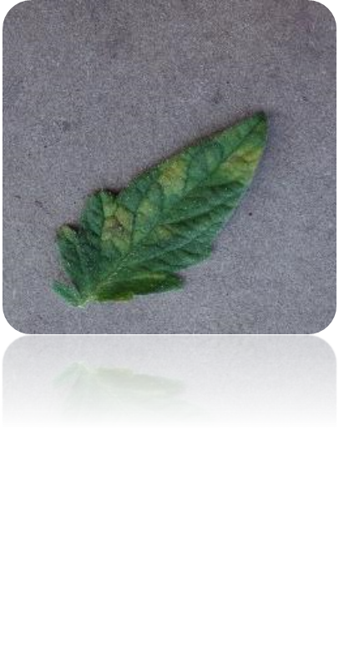
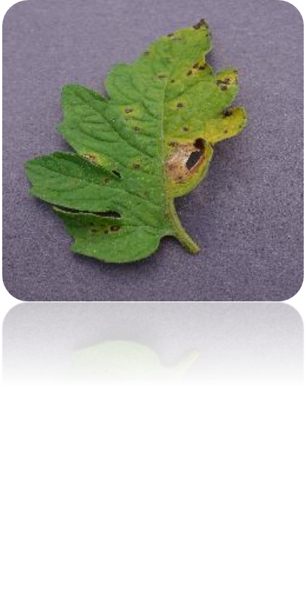
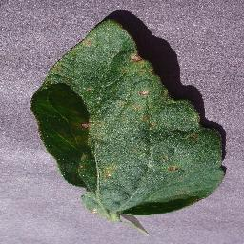
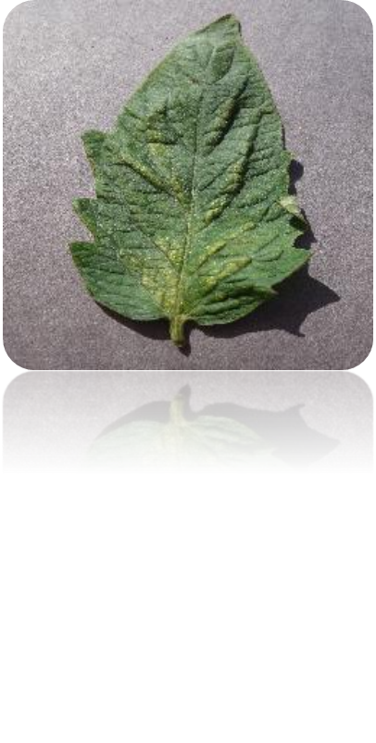
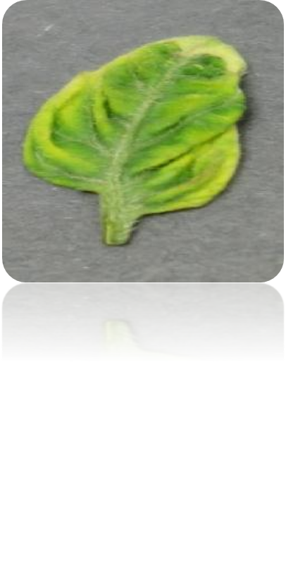
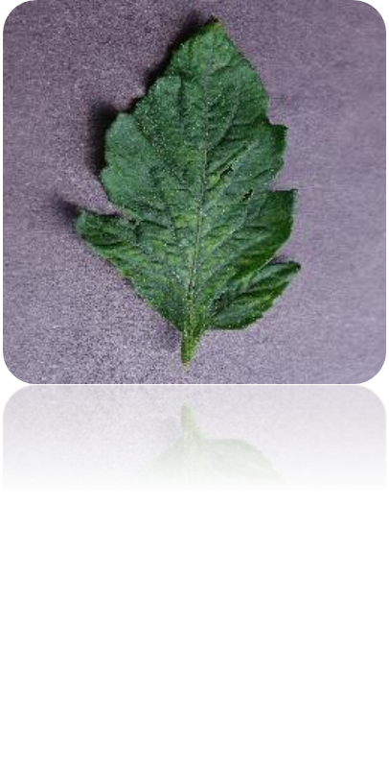
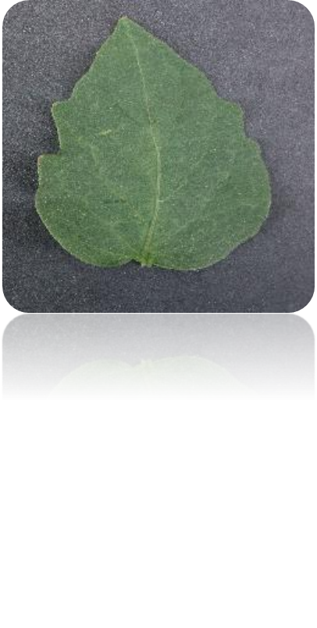
#. Image Datasets !
Tomato Late Blight
Tomato Leaf Mold
Tomato Septoria
Tomato Septoria
Tomato Early Blight
Leaf Spot & Tomato Target Spot
Tomato Spider Mites Two Spotted Spider Mite
Tomato Yellow Leaf Curl Virus
Tomato Mosaic Virus
Tomato Healthy

Slide 7
Data Description:
Precision = It is defined as what proportion of predicted positive is truly positives.
#Formula= True Positive/Total
2. Recall = It is defined as what proportion of actual positives is correctly classified .
#Formula =True Positive/Actual Yes
3. F1 Score = It is define as the average of Precision and Recall value.
#Formula = 2*( Precision*Recall ) / ( Precision + Recall )

Slide 8
Classes() | (Own Model) Precision, Recall, F1 Score | (VGG16) Precision, Recall,F1 Score | (VGG19) Precision,Recall,F1 Score | (ResNet50) Precision, Recall,F1 Score | (EfficientNetB1) Precision, Recall,F1 Score | (MobileNet) Precision, Recall,F1 Score | (EffectiveNetB0) Precision, Recall,F1 Score
Tomato Bacterial spot | 0.89, 0.90, 0.90 | 0.88 0.95 0.91 | 0.90, 0.98, 0.94 | 0.97, 0.97, 0.97 | 0.92 0.97 0.95 | 0.88 0.95 0.91 | 0.97 0.97 0.97
Tomato Early blight | 0.90, 0.79, 0.84 | 0.65 0.83 0.73 | 0.71, 0.86, 0.78 | 0.88, 0.76, 0.82 | 0.90 0.83 0.86 | 0.65 0.83 0.73 | 0.88 0.91 0.90
Tomato Late blight | 0.84, 0.76, 0.80 | 0.90 0.83 0.86 | 0.80, 0.88, 0.84 | 0.88, 0.95, 0.91 | 0.93 0.92 0.92 | 0.90 0.83 0.86 | 0.84 0.95 0.89
Tomato Leaf Mold | 0.97, 0.88, 0.92 | 0.77 0.86 0.82 | 0.71, 0.87, 0.78 | 0.94, 0.87, 0.90 | 0.85 0.93 0.89 | 0.77 0.86 0.82 | 0.93 0.93 0.93
Tomato Septoria leaf spot | 0.77, 0.84, 0.80 | 0.77 0.69 0.73 | 0.97, 0.75, 0.85 | 0.73, 0.94, 0.82 | 0.81 0.95 0.88 | 0.77 0.69 0.73 | 0.81 0.95 0.87

Slide 9
Tomato Spider mites Two-spotted spider mite | 0.86, 0.80, 0.83 | 0.88 0.85 0.86 | 0.84, 0.81, 0.82 | 0.99, 0.79, 0.88 | 0.90 0.89 0.89 | 0.88 0.85 0.86 | 0.91 0.89 0.90
Tomato Target Spot | 0.82, 0.91, 0.86 | 0.88 0.73 0.80 | 0.77, 0.76, 0.76 | 0.78, 0.82, 0.80 | 0.94 0.76 0.84 | 0.88 0.73 0.80 | 0.93 0.71 0.81
Tomato Yellow Leaf_ Curl Virus | 0.90, 0.94, 0.92 | 0.99 0.96 0.97 | 1.00, 0.91, 0.95 | 0.99, 0.98, 0.98 | 0.99 0.96 0.97 | 0.99 0.96 0.97 | 0.97 0.97 0.97
Tomato mosaic virus | 0.88, 1.00, 0.93 | 0.89 0.95 0.92 | 0.98, 0.79, 0.87 | 0.88, 0.99, 0.93 | 0.89 0.94 0.91 | 0.89 0.95 0.92 | 0.84 0.88 0.86
Tomato healthy | 0.99, 0.97, 0.98 | 0.99 0.86 0.92 | 0.98, 0.90, 0.94 | 1.00, 0.88, 0.94 | 0.95 0.90 0.92 | 0.99 0.86 0.92 | 0.95 0.83 0.89

Slide 10
Why Pre-trained model:
Time and Resource efficiency ,needs weeks & months to build a CNN form scratch , required less effort to train the parameter for future used.
Data availability ,Deep learning is data hungry need a huge amount of data to train CNN network.
We have leverage to used its pre-existing knowledge to perform well on a new, similar task, even with limited data also.

Slide 11
Pre-trained Network Used !
VGG-16
ResNet50
Mobile Net
EfficientNetB0
EfficientNetB1

Slide 12
Models | Parameters | Size(MB) | Epoch | Acc(Train) | Loss(Train) | Acc(Test) | Loss(Test)
Own Model | Total params: 10,490 Trainable params: 10,490 | - | 50 | 0.9645000 | 0.1148474 | 0.9419999 | 0.2602567
VGG16 | Total params: 21,140,042 Trainable params: 6,425,354 | 528 | 26 | 0.9697999 | 0.1047671 | 0.8510000 | 0.8213710
VGG19 | Total params: 26,449,738 Trainable params: 6,425,354 | 549 | 22 | 0.9771999 | 0.0761569 | 0.85100001 | 0.8689888
ResNet50 | Total params: 49,280,650 Trainable params: 25,692,938 | 098 | 21 | 0.9839000 | 0.080691 | 0.8949999 | 0.4781706

Slide 13
MobileNet | Total params: 16,076,746 Trainable params: 12,847,882 | 016 | 26 | 0.9771999 | 0.098631 | 0.7990000 | 0.7165103
EfficientNetB0 | Total params: 20,108,717 Trainable params: 16,059,146 | 029 | 10 | 0.9968000 | 0.0098878 | 0.8989999 | 0.7075234
EfficientNetB1 | Total params: 22,634,385 Trainable params: 16,059,146 | 031 | 20/100 | 0.99059 | 0.04307 | 0.90499 | 0.54578

Slide 14
Generalized Cluster Attached After Pre-trained Models…
Optimizer=Adom
Loss Function=Categorical Cross Entropy
Epochs=50

Slide 15
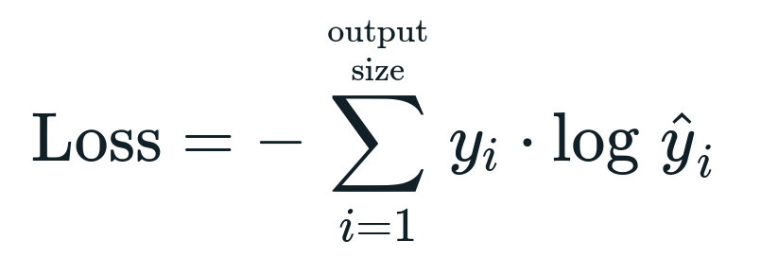
#. Formula of Categorical Cross Function !
i | Sample Size
Yi | Actual / Target Value
Yi CAP | Predicted Value

Slide 16
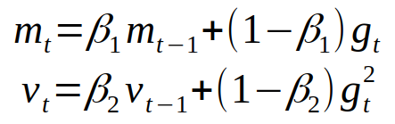
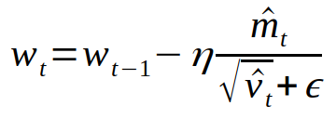
#. Adom’s Formula !
Both are come from Momentum and Adagrad concept. | Weight Updation formula !

Slide 17
1. VGG-16 (Visual Geometry Group )
Layer | Output Shape | Parameter
VGG-16 | (None,7,7,512) | 14714688
Flatten | (None,25088) | 0
Dense layer | (None,256) | 6422784
Dense output layer | (None,10) | 2570
Total Parameters | 26,449,738
Trainable Parameters | 6,425,354
Non-trainable parameters | 20,024,384

Slide 18
2. ResNet50 !
Layer | Output Shape | Parameters
Resnet50 | (None,7,7,2048) | 23587712
Flatten | (None,100352) | 0
Dense | (None,256) | 25690368
Dropout | (None,256) | 0
Dense (Output layer) | (None,10) | 2570
Total Parameter | 49,280,650
Trainable Parameter | 25,692,938
Non-Trainable Parameter | 23,587,712

Slide 19
3. Mobile Net !
layer | Output Shape | Parameter
Mobile net | (None,7,7,1024) | 3228864
Flatten | (None,50176) | 0
Dense | (None,256) | 12845312
Dropout | (None,256) | 0
Dense (output layer) | (None,10) | 2570
Total Param | 16,076,746
Trainable Param | 12,847,882
Non-Trainable Param | 3,228,864

Slide 20
4. EfficientNetB0!
Layer | Output Shape | Param
Efficientnetb0 | (None,7,7,1280) | 4049571
Flatten | (None,62720) | 0
Dense | (None,256) | 16056576
Dropout | (None,256) | 0
Dense(output layer) | (None,10) | 2570
Total Parameter | 20,108,717
Trainable Parameter | 16,059,146
Non-Trainable Parameter | 4,049,571

Slide 21
5. EfficientNetB1 !
Layer | Output Shape | Param
Efficientnetb1 | (None,7,7,1280) | 6575239
Flatten | (None,62720) | 0
Dense | (None,256) | 16056576
Dropout | (None,256) | 0
Dense(output layer) | (None,10) | 2570
Total Parameter | 22,634,385
Trainable Parameter | 16,059,146
Non-Trainable Parameter | 6,575,239

Slide 22
#. Result:
Model | Top-1 Accuracy | Top-5 Accuracy | Correct Prediction | Total Prediction | In (%) Correct P.
VGG-16 | 73.3% | 90.1% | 841 | 1000 | 84.1
ResNet50 | 74.9% | 92.1% | 972 | 1000 | 97.2
Mobile Net | 70.4% | 89.5% | 799 | 1000 | 79.9
Efficient NetB0 | 77.7% | 93.3% | 899 | 1000 | 89.9
Efficient NetB1 | 80.1% | 94.9% | 899 | 1000 | 89.9

Slide 23
#. Custom Network :
Created Models | Conv Layers | Max Pool layers | Global Average Pooling Layer | Dense (Output layer) | Accuracy in (%) | Loss in (%)
First Model | 3 | 3 | 1 | 1 | 88 | 33
Second Model | 2 | 2 | 1 | 1 | 79 | 63
Third Model | 4 | 4 | 1 | 1 | 83 | 59

Slide 24
#. Custom Network Summary :
Created Models | Total Param | Trainable Param | Non-Trainable Param | Correct Prediction | Total Prediction | In (%) correct prediction
First Model | 10,490 | 10,490 | 0 | 904 | 1000 | 90.4
Second Model | 5,690 | 5,690 | 0 | 792 | 1000 | 79.2
Third Model | 29,306 | 29,306 | 0 | 821 | 1000 | 82.1

Slide 25
#. Result !
Custom network ,first model get better performance over the other two model.
Our model classifying correctly at the highest probability which is belong to correct class but it is not exactly equal to truth value of that particular class.
Loss is 33% ,reason is the gap between truth value and actual value of that particular class , After summation of whole sample ,it got maximize.

Slide 26
Experimental Setup:
Plate form – Kaggle
Dataset - Plant Village
GPU Version-NIVIDA GPU T4*2
Batch Size – 32
Optimizer – Adom
Loss Function – Categorical Cross Entropy.
Epoch- 50
Train/Validation/Test – 70/20/10 (Ratio%)

Slide 27
#. Conclusion !
Trained custom CNN from scratch with an accuracy of 87% ,we have got after evaluation.
Pre-trained model,EfficienNetB0 give the optimal accuracy with an 99% on our datasets.

Slide 28
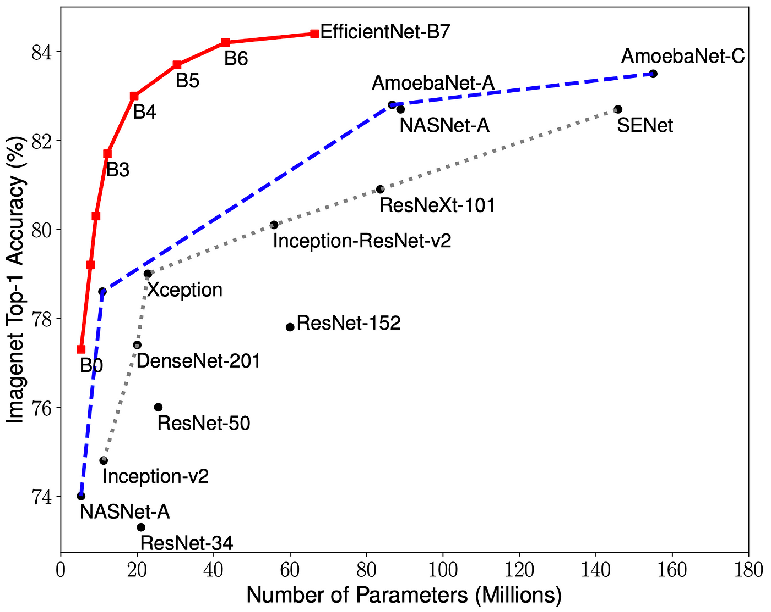
#.Models Interpretation!

Slide 29


